Slide 1


Introduction to Cypress

Slide 2
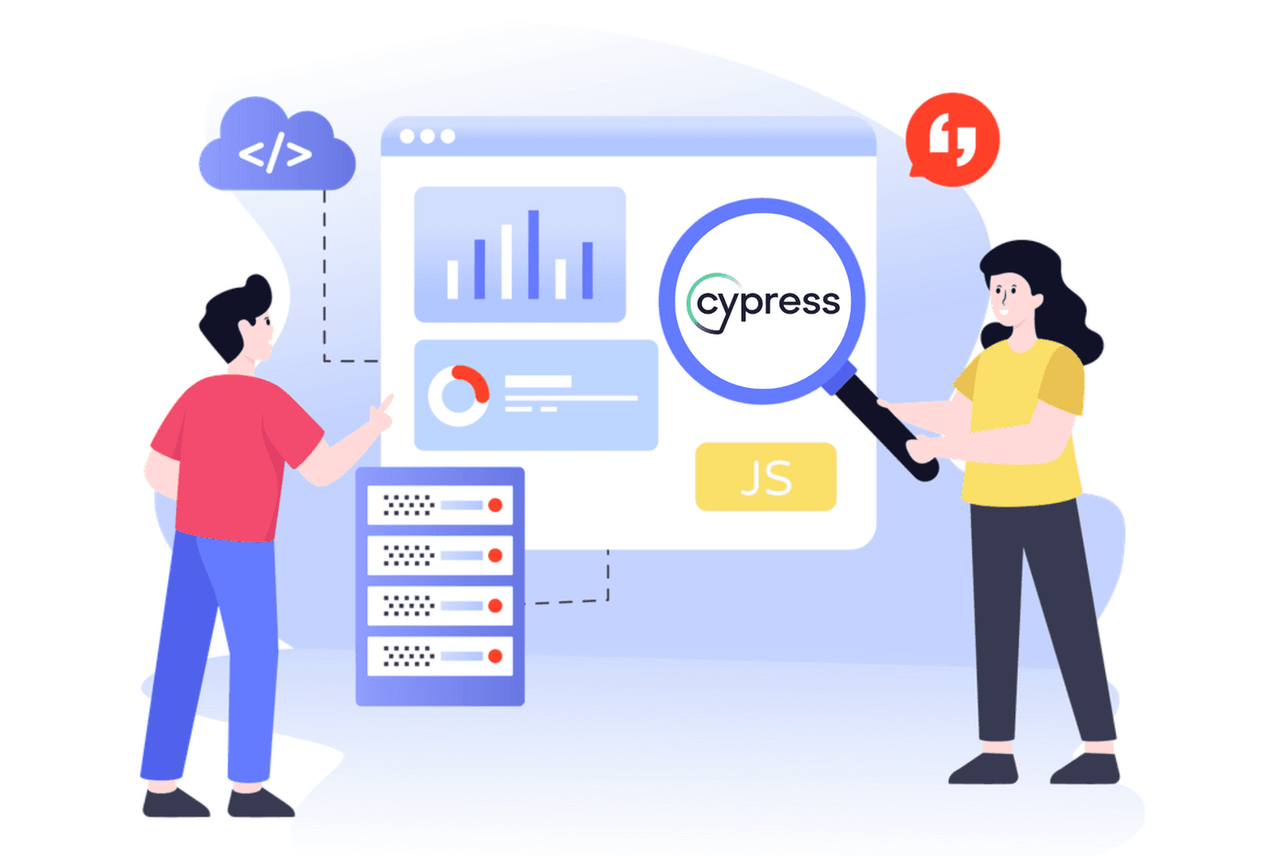
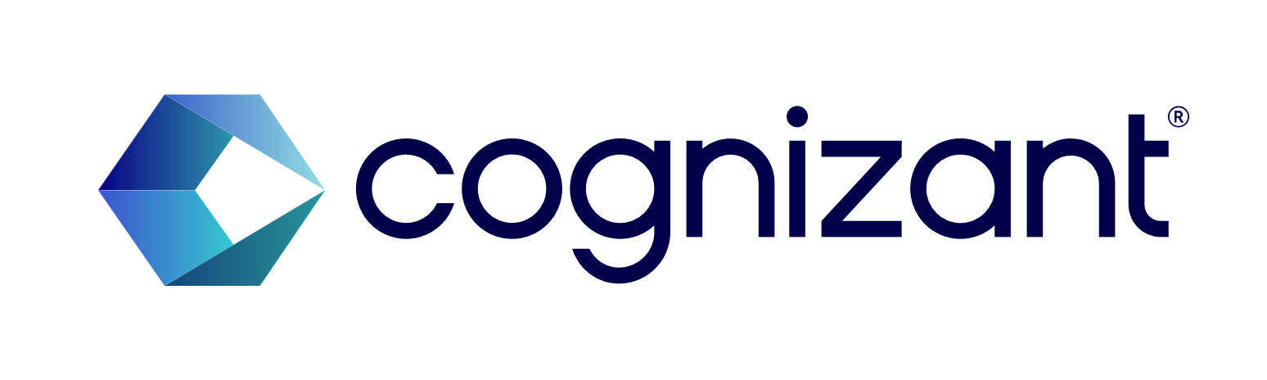
Topics are going to Discuss
What is Cypress?
Advantages of Cypress Over Other Tools
Supported Browsers
2
© 2025 Cognizant | Private

Slide 3
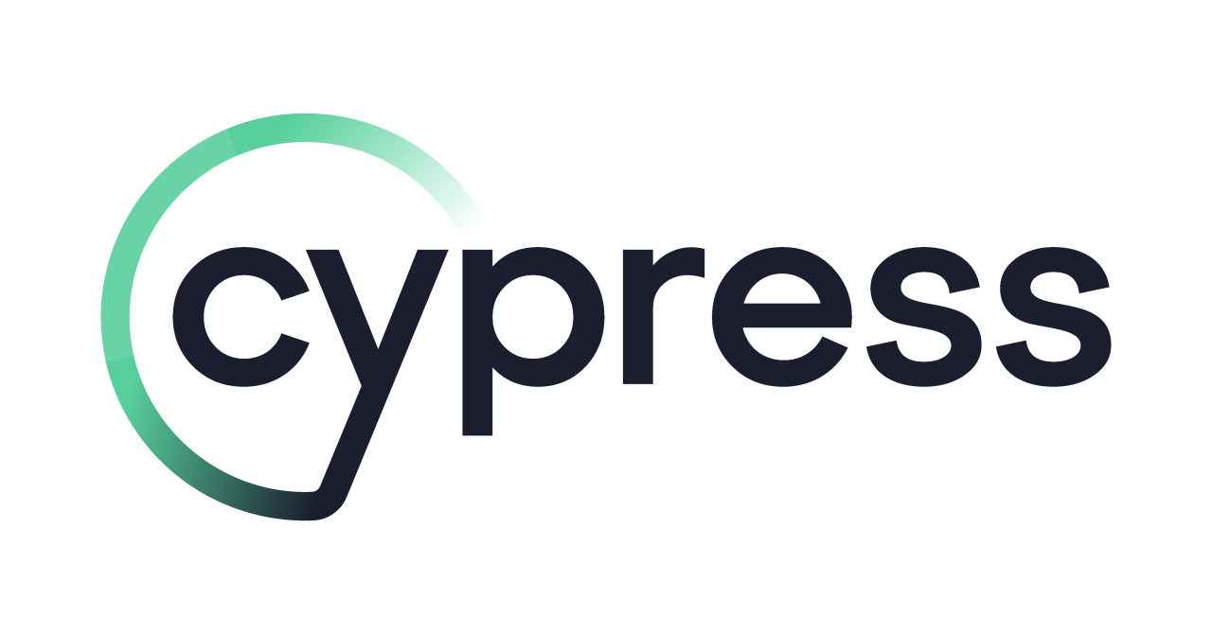

What is Cypress?
Cypress is an open-source end-to-end testing framework designed for web applications.
Cypress runs directly in the browser, which makes it better at simulating user interactions with a website.
Cypress uses JavaScript for writing tests.
Why Choosing Cypress ?
Powerful Framework
Modern Approach
Visual Test Runner
Built-In Debugging Tools
Increasing Popularity
Key Benefits of Cypress :
Improved Test Reliability
Faster Test Execution
Easy Debugging
Seamless Integration
Comprehensive Documentation and Community Support
3
© 2025 Cognizant | Private
Notes:
Let’s understand
What is Cypress ?
Cypress is an open-source end-to-end testing framework designed for web applications. It addresses common issues like synchronization problems and test inconsistencies caused by elements not being visible. Unlike traditional testing tools that use WebDriver, Cypress interacts directly with the application, making it faster and more reliable for automating user interaction tests. Built on Node.js and available as an npm module, Cypress uses JavaScript for writing tests. Its inbuilt commands are easy to understand, making it accessible for a wide range of users.
Why Choosing Cypress ?
Powerful Framework: Allows QA engineers to write automated tests quickly and efficiently.
Modern Approach: Integrates seamlessly with modern front-end frameworks such as React, Angular, and Vue.
Visual Test Runner: Offers a visual representation of test runs, making it easy to identify and troubleshoot issues.
Built-In Debugging Tools: Provides tools for easy diagnosis and quick fixes of issues.
Increasing Popularity: Cypress is gaining traction in the QA industry due to its unique features and capabilities.
Key Benefits of Cypress :
Improved Test Reliability: Cypress automatically waits for elements to appear and animations to complete, reducing flaky tests.
Faster Test Execution: Direct interaction with the application makes tests run faster compared to traditional tools.
Easy Debugging: Built-in debugging tools and clear error messages help QA automation engineers quickly diagnose and fix issues.
Seamless Integration: Works well with modern front-end frameworks like React, Angular, and Vue.
Comprehensive Documentation and Community Support: Extensive resources and a supportive community make it easier for QA automation engineers to get started and find solutions.

Slide 4
What is Cypress?
Standout Features:
Real-Time Preview: Watch tests run live in the browser.
Automatic Waiting: No need for manual waits or sleeps.
Powerful API: Easy interaction with web elements.
Cross-Browser Support: Ensures compatibility across browsers.
Fast Execution: Speedy and reliable test runs.
Time Travel: Snapshots for each test step.
Mocking & Stubbing: Control and test edge cases easily.
Different Types of Tests Performed with Cypress :
E2E Testing: Simulates real user interactions, covering the entire workflow.
Component Testing: Tests individual components in isolation.
Unit Testing: Focuses on testing individual units or functions.
API Testing: Tests backend APIs for correct responses.
Accessibility testing: Ensures the application is usable by people with disabilities
4
© 2025 Cognizant | Private
Notes:
Let's see the detailed explanations for each key standout feature of Cypress and the different types of tests performed with Cypress:
Let’s See Standout Features:
Real-Time Preview:
Cypress allows you to watch your tests run live in the browser. This real-time feedback helps you see exactly what is happening at each step, making it easier to identify and fix issues immediately.
Automatic Waiting:
Cypress automatically waits for elements to be visible and ready before interacting with them. This eliminates the need for manual waits or sleeps, reducing flakiness and making tests more reliable.
Powerful API:
Cypress provides a powerful and easy-to-use API for interacting with web elements. Commands like cy.get(), cy.click(), and cy.type() make it straightforward to simulate user interactions.
Cross-Browser Testing Support:
Cypress supports testing across multiple browsers, including Chrome, Firefox, and Edge. This ensures that your application works consistently across different environments.
Fast Execution:
Tests run directly in the browser, providing fast and reliable execution. Cypress's architecture allows for quick feedback, which is crucial for continuous integration and delivery.
Time Travel:
Cypress captures snapshots of your application at each step of the test. You can "time travel" back to any point in the test to see what the application looked like, making it easier to debug and understand test failures.
Mocking & Stubbing:
Cypress includes built-in capabilities for mocking and stubbing API requests. This allows you to control and test edge cases easily, ensuring your application handles different scenarios correctly.
Now let’s see Different Types of tests Preformed with Cypress:
End-to-End (E2E) Testing: Simulates real user interactions with the application, covering the entire workflow from start to finish.
Component Testing: Allows testing of individual components in isolation, ensuring they function as expected.
Unit Testing: Focuses on testing individual units or functions of the code to ensure they perform as intended.
API Testing: Tests the application's backend APIs to ensure they respond correctly to various requests.
Accessibility Testing: Ensures the application is usable by people with disabilities, meeting accessibility standards.

Slide 5
QUIZE
Question | A | B | C | D | Answer
What is Cypress? | A database management system | A web development framework | An end-to-end testing framework | A version control system | C
Which programming language is used for writing tests in Cypress? | Python | Java | JavaScript | Ruby | C
What makes Cypress faster and more reliable compared to traditional testing tools? | It uses WebDriver | It interacts directly with the application | It runs on a separate server | It uses a different programming language | B
Why is Cypress gaining popularity in the QA industry? | It is expensive | It has unique features and capabilities | It is difficult to use | It has limited support | B
What feature of Cypress helps in identifying and troubleshooting issues easily? | Visual Test Runner | WebDriver | Separate server | Limited error messages | A
5
© 2025 Cognizant | Private
Notes:
Lets try to find answer for the quizzes

Slide 6
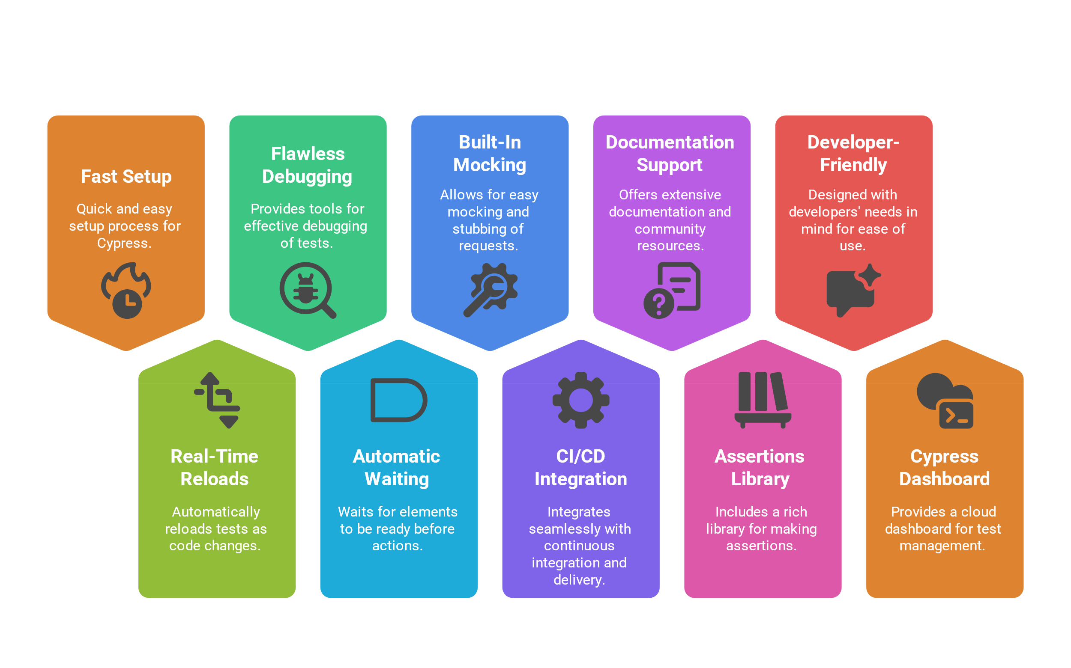
Advantage of Cypress Over Other Tools
6
© 2025 Cognizant | Private
Notes:
Let’s see the Advantage of Cypress Over Other Tools:
Fast Setup:
Cypress installs quickly and integrates seamlessly into existing projects, reducing setup time.
Tests execute directly in the browser, significantly speeding up the process.
Real-Time Reloads:
You can write or modify tests and see the results immediately, thanks to Cypress's real-time reload feature.
Flawless Debugging:
Cypress provides detailed error messages and stack traces, making it easier to identify and resolve issues.
Debugging directly within the browser using developer tools simplifies the process.
Automatic Waiting:
Cypress automatically waits for elements to load, DOM updates to complete, or animations to finish before executing assertions, eliminating the need for manual wait commands.
Built-In Mocking and Stubbing:
Cypress has built-in capabilities for mocking and stubbing API requests, ensuring stable and predictable test environments.
Integration with CI/CD:
Cypress integrates smoothly with CI/CD pipelines, supporting tools like Jenkins, CircleCI, and GitHub Actions.
Documentation and Community Support:
Cypress boasts extensive and well-organized documentation, making it easy for beginners to get started.
Its growing community provides plugins, examples, and support.
Rich Assertions Library:
Cypress provides a rich assertion library built on top of Chai, offering a variety of methods to verify different aspects of your application, including element properties, text content, attributes, and more, all seamlessly integrated into your test syntax.
Developer-Friendly Architecture:
Cypress operates directly within the browser environment, providing native access to every DOM element, making tests more reliable and quicker to execute
Cypress Dashboard (Cypress Cloud)
Provides full visibility into test runs, especially in CI pipelines.
Cypress Cloud is an enterprise-ready companion to the open-source Cypress app, designed to enhance the testing experience in Continuous Integration (CI) environments
Here are some key features:
Smart Orchestration: Optimizes test runs by parallelizing them, reducing test time
Visual Reviews: Provides visual representations of test runs for easy debugging
Test Analytics: Offers insights into test performance and project health
Failure Debugging: Captures error details, including stack traces, screenshots, and videos
Flake Detection: Detects flaky tests and provides historical data
CI Integration: Integrates with CI tools like GitHub, GitLab, and Bitbucket

Slide 7
QUIZE
Question | A | B | C | D | Answer
What feature of Cypress allows you to see test results immediately after writing or modifying tests? | Fast Setup | Real-Time Reloads | Flawless Debugging | Automatic Waiting | B
Which Cypress feature helps in identifying and resolving issues with detailed error messages and stack traces? | Fast Setup | Real-Time Reloads | Flawless Debugging | Built-In Mocking and Stubbing | C
How does Cypress handle waiting for elements to load or animations to complete? | Manual wait commands | Automatic Waiting | Real-Time Reloads | Fast Setup | B
What built-in capabilities does Cypress offer for ensuring stable and predictable test environments? | Fast Setup | Real-Time Reloads | Built-In Mocking and Stubbing | Flawless Debugging | C
Which tools does Cypress integrate with for CI/CD pipelines? | Jenkins, CircleCI, and GitHub Actions | Django, Flask, and Pyramid | Spring, Hibernate, and Struts | Laravel, Symfony, and CodeIgniter | A
7
© 2025 Cognizant | Private
Notes:
Lets try to find answer for the quizzes

Slide 8
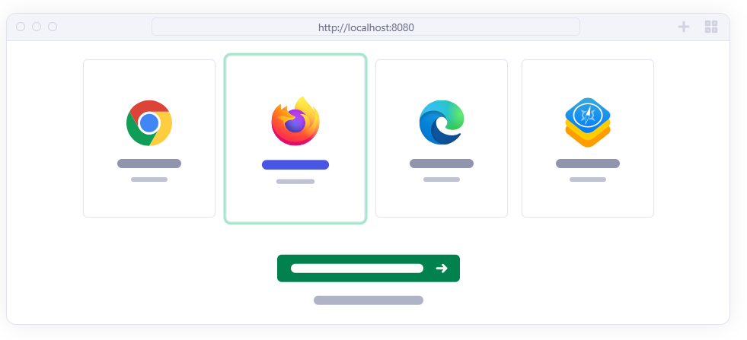
Supported Browsers
Cypress supports modern web browsers.
Cypress supports multiple browsers to ensure cross-compatibility.
Cypress supports both Chromium-based and non-Chromium browsers.
List of Supported Browser:
Chromium-Based Browsers:
Chrome.
Edge.
Electron.
Brave.
Non-Chromium Browsers:
Firefox.
WebKit.
8
© 2025 Cognizant | Private
Notes:
Here’s an explanation of the supported browsers for Cypress:
Cypress is designed to work with modern web browsers, ensuring that your tests can run on the latest versions of popular browsers.
It automatically detects and switches between browsers, ensuring seamless application performance.
Cypress facilitates this by allowing tests to be run on multiple browsers.
Cypress is versatile in its browser support, covering both Chromium-based and non-Chromium browsers
List of Supported Browsers:
Chromium-Based Browsers:
Chrome Family: Chrome, Chrome Beta, Chrome Canary, and Chromium.
Microsoft Edge: Edge, Edge Beta, Edge Canary, and Edge Dev.
Electron: A version of Chromium that comes bundled with Cypress.
These browsers share the same underlying engine, making it easier to ensure compatibility across them
And Electron is Default browser in cypress.
Non-Chromium-Based Browsers:
Firefox Family: Firefox, Firefox Developer Edition, and Firefox Nightly.
WebKit (Experimental): Safari's browser engine.
which uses the Gecko engine, and WebKit (Safari's engine), providing a broader range of testing environments

Slide 9

Supported Browsers
Key Features of Cypress Browser Support:
Automatic Detection: Cypress can automatically detect the browsers installed on the system, making it easy to switch between them for testing.
Cross-Browser Testing: It supports testing across multiple browsers, including Chrome, Firefox, and Edge, ensuring the application works consistently across different environments.
Customizable: Cypress allows for extensive customization, enabling the testing environment and configurations to be tailored to specific needs.
Headless: Tests can be run in a headless mode, which means tests can be executed without opening a browser window, speeding up the testing process and making it suitable for CI/CD pipelines.
9
© 2025 Cognizant | Private
Notes:
Let’s Understand the Key Features of Cypress Browser Support:
Automatic Detection: This feature allows the browser to automatically detect and adapt to different environments, ensuring compatibility and optimal performance without manual intervention.
Cross-Browser Testing: This is crucial for ensuring that web applications work seamlessly across different browsers (like Chrome, Firefox, Safari, etc.). It helps identify and fix compatibility issues.
Customizable: Customizability allows users to tailor the browser's functionality and appearance to their specific needs, enhancing user experience and productivity.
Headless: Run without a graphical user interface (GUI). This mode speeds up the testing process and is useful in environments where a GUI is unavailable.

Slide 10
QUIZE
Question | A | B | C | D | Answer
Which browsers does Cypress support for running tests? | Only Chrome | Only Firefox | Both Chromium-based and non-Chromium browsers | Only Safari | C
Which browser is bundled with Cypress by default? | Chrome | Firefox | Electron | Safari | B
What is the key feature of Cypress that allows it to automatically detect and switch between browsers? | Cross-Browser Testing | Automatic Detection | Customizable | Real-Time Reloads | B
Which family of browsers is included in the Chromium-based browsers supported by Cypress? | Chrome Family and Microsoft Edge | Firefox Family and Safari | Internet Explorer and Opera | Safari and Opera | A
What is the experimental non-Chromium-based browser engine supported by Cypress | Gecko | WebKit | Blink | Trident | B
10
© 2025 Cognizant | Private

Slide 11
Topics covered in the session Introduction to Cypress Advantages of Cypress Over Other Tools Supported Browsers
Thank you!
Notes:
Thanks for exploring on Functions:
What is Cypress?
Advantages of Cypress Over Other Tools
Supported Browsers

